Slide 1
UNIT 2
PROGRAMMING IN PYTHON

Slide 2
Files
Files are a way to store data permanently
Treated as data streams
Operations on files:
1.Creating a file:
Myfile=open(‘myfile’, ‘w’)
Modes :
a – Appends all the output to the end of the file
r- Read only
r+ - input and output mode
w – Output mode for writing
w+ - input and output mode-file is overwritten if it already exists
ab, rb, r+b, wb, w+b – for binary files

Slide 3
Reading from a file
Three functions: read(N), readline(), readlines()
If file doesn’t exist, an error is caused.
f=open(“myfile”,”w”)
f.write(“.......................”)
f.close()
try:
f=open(“myfile”,”r”)
f.readlines()
f.close()
except IOError:
print(“File does not exist”)

Slide 4
Iterating through files
try :
file = open("payroll", "r")
except IOError :
print "The file doesn’t exist . Check filename ."
individuals = file.readlines ()
print "Account". ljust (10) , #comma prevents newline
print "Name". ljust (10) ,
print "Amount". rjust(10)
for record in individuals :
columns = record.split ()
print columns [0].ljust (10)
print columns [1].ljust (10)
print columns [2].rjust (10)
file.close()

Slide 5
Seeking
>>> file.seek(15)
>>>file.seek(20,1)
>>>file.seek(-30,2)
>>>file.seek(0,2)
Tell() method- returns current pointer postion

Slide 6
Serialization
Serialization (pickling) allows you to save non-textual information to memory or transmit it over a network. Pickling essentially takes any data object, such as dictionaries, lists, etc and converts it into a byte set that can be used to reconstitute the original data.
>>import cPickle #impor t cPickle library
>>> a_list = [ "one " , " two" , " buckle" , " my " , " shoe" ]
>>> save_file = open ( "pickled_list" , " w" )
>>> cPickle.dump ( a_list , save_file ) #serialize list to file
>>> file.close ( )
>>> open_file = open ("pickled_list " , "r" )
>>> b_list = cPickle.load (open_file )

Slide 7
Shelves
>>>import shelve #impor t shelve library
>>> a_list = [ "one" , "two" , "buckle " , "my" , "shoe " ]
>>>dbase = shelve.open ( " filename " )
>>>dbase [ "rhyme" ] = a_list #save list under key name
>>> b_list = dbase [ "rhyme" ] #retrieve list

Slide 8

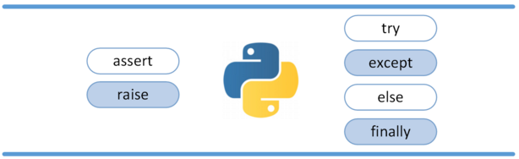
Exceptions

Slide 9
Exceptions
Exceptions are events that modify program’s flow, either intentionally or due to errors.
They are special events that can occur due to an error, e.g. trying to open a file that doesn’t exist, or when the program reaches a marker, such as the completion of a loop.
Here are just a few examples:
• Accessing a non−existent dictionary key will raise a KeyError
exception.
• Searching a list for a non−existent value will raise a ValueError
exception.
• Calling a non−existent method will raise an AttributeError exception.
• Referencing a non−existent variable will raise a NameError exception.
• Mixing datatypes without coercion will raise a TypeError exception.

Slide 10
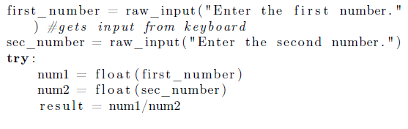
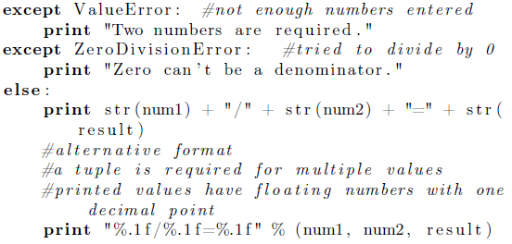
Example

Slide 11
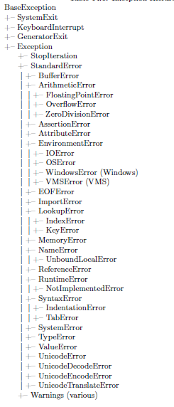
Exception Hierarchy

Slide 12
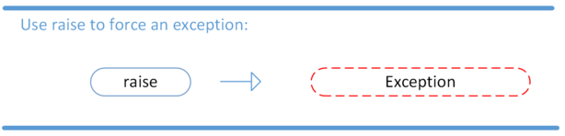
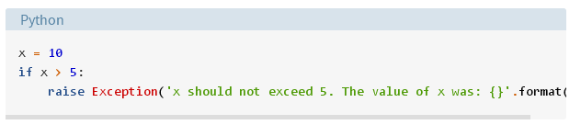
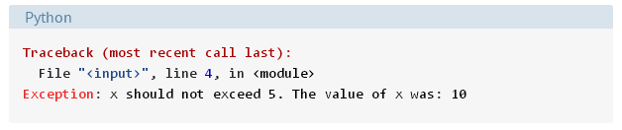
Raising an Exception
We can use raise to throw an exception if a condition occurs. The statement can be complemented with a custom exception.

Slide 13
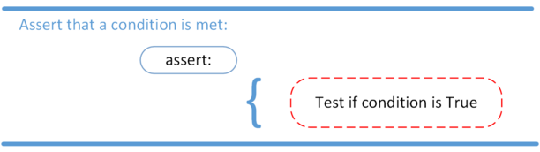
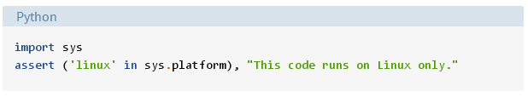
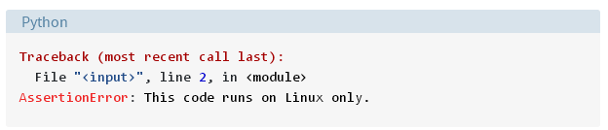
AssertionError Exception
Instead of waiting for a program to crash midway, you can also start by making an assertion in Python. We assert that a certain condition is met. If this condition turns out to be True, then that is excellent! The program can continue. If the condition turns out to be False, you can have the program throw an AssertionError exception.

Slide 14
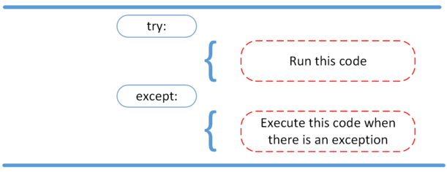
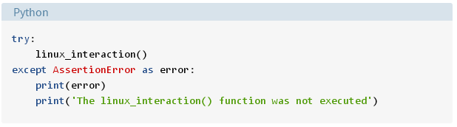
Try and except block

Slide 15
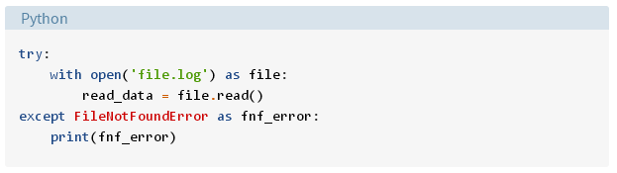
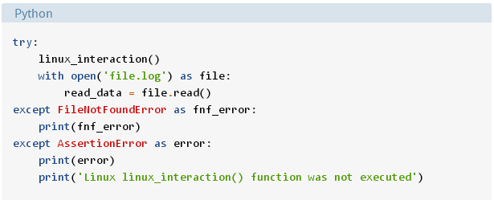

Slide 16
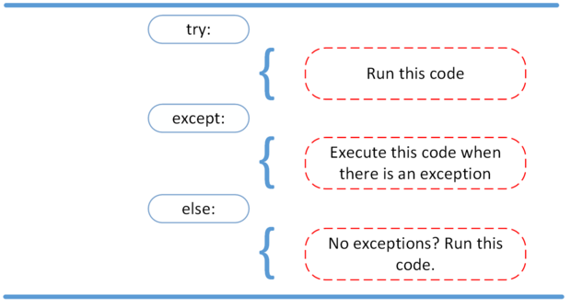
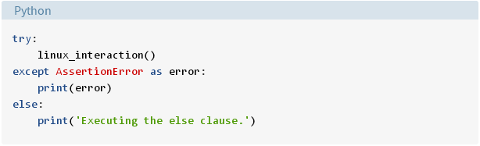
The else clause

Slide 17
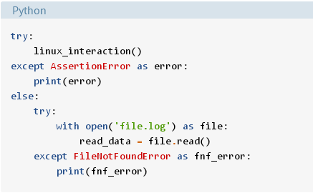

Slide 18
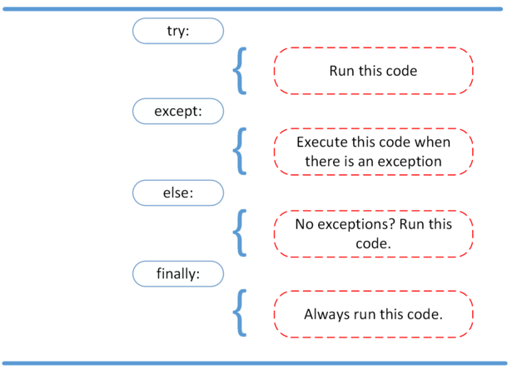
Finally caluse

Slide 19
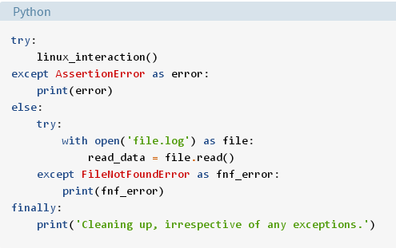

Slide 20
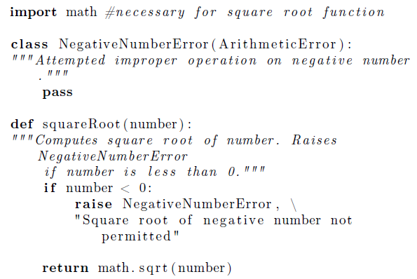
Custom Exception

Slide 21
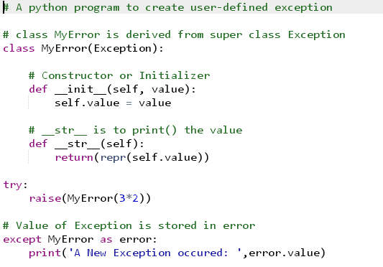
User-defined exception

Slide 22
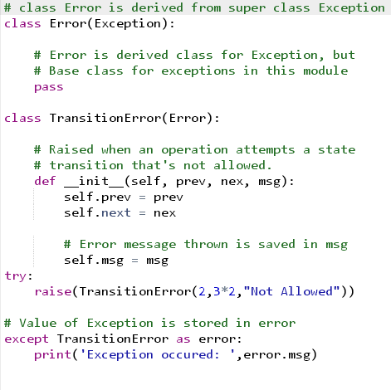
User-defined exception

Slide 23
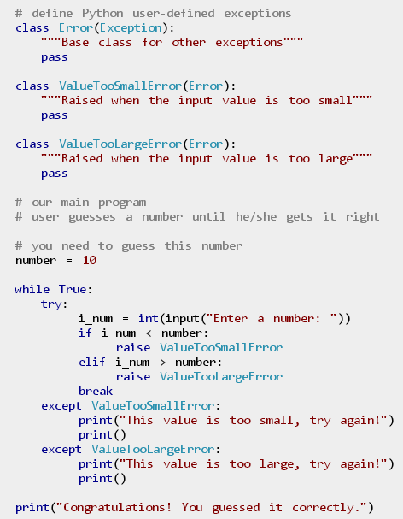

Slide 24
EXCEPTIONS IN PYTHON
Base Classes:
1.exception BaseException
This is the base class for all built-in exceptions. It is not meant to be directly inherited by user-defined classes. This class is responsible for creating a string representation of the exception using str() using the arguments passed. An empty string is returned if there are no arguments.
2.exception Exception
This is the base class for all built-in non-system-exiting exceptions. All user-defined exceptions should also be derived from this class.
Notes:
Accessing a non−existent dictionary key will raise a KeyError
exception.
• Searching a list for a non−existent value will raise a ValueError
exception.
• Calling a non−existent method will raise an AttributeError exception.
• Referencing a non−existent variable will raise a NameError exception.
• Mixing datatypes without coercion will raise a TypeError exception.

Slide 25
EXCEPTIONS IN PYTHON
3. exception ArithmeticError
This class is the base class for those built-in exceptions that are raised for various arithmetic errors such as :
OverflowError
ZeroDivisionError
FloatingPointError
try:
a = 10/0
print a
except ArithmeticError:
print "This statement is raising an arithmetic exception."
else:
print "Success.“
Output:
This statement is raising an arithmetic exception.

Slide 26
EXCEPTIONS IN PYTHON
4. exception BufferError
This exception is raised when buffer related operations cannot be performed.
5. exception LookupError
This is the base class for those exceptions that are raised when a key or index used on a mapping or sequence is invalid or not found. The exceptions raised are :
KeyError
IndexError

Slide 27
EXCEPTIONS IN PYTHON
try:
a = [1, 2, 3]
print a[3]
except LookupError:
print "Index out of bound error."
else:
print "Success"
Output:
Index out of bound error.

Slide 28
EXCEPTIONS IN PYTHON
Concrete exceptions: Exceptions that are usually raised.
1.exception AssertionError
An AssertionError is raised when an assert statement fails.
When it encounters an assert statement, Python evaluates the accompanying expression, which is hopefully true. If the expression is false, Python raises an AssertionError exception. The syntax for assert is: assert Expression[, Arguments]
2. exception AttributeError
An AttributeError is raised when an attribute reference or assignment fails such as when a non-existent attribute is referenced.
class Attributes(object):
pass
object = Attributes()
print object.attribute
Output:
Traceback (most recent call last): File "d912bae549a2b42953bc62da114ae7a7.py", line 5, in print object.attribute
AttributeError: 'Attributes' object has no attribute 'attribute'

Slide 29
EXCEPTIONS IN PYTHON
3. exception EOFError
An EOFError is raised when built-in functions like input() hits an end-of-file condition (EOF) without reading any data. The file methods like readline() return an empty string when they hit EOF.
while True:
data = raw_input('Enter name : ')
print 'Hello ', data
4. exception FloatingPointError
A FloatingPointError is raised when a floating point operation fails. This exception is always defined, but can only be raised when Python is configured with the–with-fpectl option, or the WANT_SIGFPE_HANDLER symbol is defined in the pyconfig.h file.

Slide 30
EXCEPTIONS IN PYTHON
5. exception GeneratorExit
This exception directly inherits from BaseException instead of Exception since it is technically not an error. A GeneratorExit exception is raised when a generator or coroutine is closed.
Output:
Yielding 0
0
Exiting early
def my_generator(): try: for i in range(5): print 'Yielding', i yield i except GeneratorExit: print 'Exiting early' g = my_generator() print g.next() g.close()

Slide 31
EXCEPTIONS IN PYTHON
6. exception ImportError
An ImportError is raised when the import statement is unable to load a module or when the “from list” in from … import has a name that cannot be found.
7. exception ModuleNotFoundError
This is the subclass of ImportError which is raised by import when a module could not be found. It is also raised when None is found in sys.modules.
8. exception IndexError
An IndexError is raised when a sequence is referenced which is out of range.
array = [ 0, 1, 2 ] print array[3]

Slide 32
EXCEPTIONS IN PYTHON
9. exception KeyError
A KeyError is raised when a mapping key is not found in the set of existing keys.
10. exception KeyboardInterrupt
This error is raised when the user hits the interrupt key such as Control-C or Delete.
11. exception MemoryError
This error is raised when an operation runs out of memory.
array = { 'a':1, 'b':2 } print array['c']

Slide 33
EXCEPTIONS IN PYTHON
12. NameError
This error is raised when a local or global name is not found. For example, an unqualified variable name.
def func():
print ans
func()
13. exception NotImplementedError
This exception is derived from RuntimeError. Abstract methods in user defined classed should raise this exception when the derived classes override the method.
14. exception OSError
The OSError exception is raised when a system function returns a system-related error, including I/O failures such as “file not found” or “disk full” errors.

Slide 34
EXCEPTIONS IN PYTHON
15. exception OverflowError
The OverflowError is raised when the result of an arithmetic operation is out of range. Integers raise MemoryError instead of OverflowError. OverflowError is sometimes raised for integers that are outside a required range.
16. exception RecursionError
The RecursionError is derived from the RuntimeError. This exception is raised when the interpreter detects that the maximum recursion depth is exceeded.
17. exception ReferenceError
The ReferenceError is raised when a weak reference proxy is used to access an attribute of the referent after the garbage collection.

Slide 35
EXCEPTIONS IN PYTHON
18. exception RuntimeError
The RuntimeError is raised when no other exception applies. It returns a
19. exception StopIteration
The StopIteration error is raised by built-in function next() and an iterator‘s __next__() method to signal that all items are produced by the
iterator.string indicating what precisely went wrong.
Arr = [3, 1, 2] i=iter(Arr) print i print i.next() print i.next() print i.next() print i.next()

Slide 36
EXCEPTIONS IN PYTHON
20. exception SyntaxError
The SyntaxError is raised when the parser encounters a syntax error. A syntax error may occur in an import statement or while calling the built-in functions exec() or eval(), or when reading the initial script or standard input.
21. exception TypeError
TypeError is raised when an operation or function is applied to an object of inappropriate type. This exception returns a string giving details about the type mismatch.
22. exception ValueError
A ValueError is raised when a built-in operation or function receives an argument that has the right type but an invalid value.

Slide 37
EXCEPTIONS IN PYTHON
23. exception ZeroDivisionError
A ZeroDivisionError is raised when the second argument of a division or modulo operation is zero. This exception returns a string indicating the type of the operands and the operation.

Slide 38
EXCEPTIONS IN PYTHON
# Python program to handle simple runtime error
a = [1, 2, 3]
try:
print "Second element = %d" %(a[1])
# Throws error since there are only 3 elements in array
print "Fourth element = %d" %(a[3])
except IndexError:
print "An error occurred“
Output:
Second element = 2
An error occurred

Slide 39
EXCEPTIONS IN PYTHON
# Program to handle multiple errors with one except statement
try :
a = 3
if a < 4 :
# throws ZeroDivisionError for a = 3
b = a/(a-3)
# throws NameError if a >= 4
print "Value of b = ", b
# note that braces () are necessary here for multiple exceptions
except(ZeroDivisionError, NameError):
print "\n Error Occurred and Handled"
Output:
Error Occurred and Handled

Slide 40
EXCEPTIONS IN PYTHON
# Program to depict else clause with try-except
# Function which returns a/b
def AbyB(a , b):
try:
c = ((a+b) / (a-b))
except ZeroDivisionError:
print "a/b result in 0"
else:
print c
# Driver program to test above function
AbyB(2.0, 3.0)
AbyB(3.0, 3.0)
Output:
-5.0
a/b result in 0

Slide 41
EXCEPTIONS IN PYTHON
The raise statement allows the programmer to force a specific exception to occur. The sole argument in raise indicates the exception to be raised. This must be either an exception instance or an exception class (a class that derives from Exception)
# Program to depict Raising Exception
try:
raise NameError("Hi there") # Raise Error
except NameError:
print "An exception"
raise # To determine whether the exception was raised or not
Output:
Traceback (most recent call last): File "003dff3d748c75816b7f849be98b91b8.py", line 4, in raise NameError("Hi there") # Raise Error
NameError: Hi there

